Slide 1
Web and mobile app development – csc3054/7054
5.2 Internal storage

Slide 2

“Belfast event finder” application
To develop an event finding app to help with promotion of local events and festivals.
“Open Data” is freely available to the public, which forms the basis of entering information into the app.

Slide 3
Questions to be answered
How many options do we have for data storage?
For internal storage:
How do we create a EditText field?
How to create openFileInput()/openFileOutput() for write/read?
Why do we use FileInputStream() and how?
How to create a EditText field on the layout file?

Slide 4
Content outline
Options for data storage
Internal storage
Summary
Next lecture
Further readings

Slide 5
Options for data storage
Shared preferences: private data is stored in key-value pairs.
Internal storage: save files on the device’s internal storage.
Local cache: use the getCacheDir() method to create the cache.
External storage: such as removable storage (SD card) or nonremovable internal storage. Use a call to getExternalStorageState() to check the availability of media.

Slide 6
Continued…
SQLite database: a lightweight SQL (Structured Query Language) database.
Network connection: remote storage.

Slide 7
Content outline
Options for data storage
Internal storage
Summary
Next lecture
Further readings

Slide 8
Demo and design
MainActivity.java
To create an EditText field.
To create interactive UI components.
To use a save class for opening a file and then writing data to the file.
To use a read class for opening a file and then passing the characters to a string.
Activity_main.xml
To create two buttons, one for read and one for write.
To create an EditText for typing in data.
String.xml
To show toasts for read and write operations.

Slide 9
Reading file
In order to read the contents of a file, call the openFileInput() method and then return an instance of FileInputStream.
FileInputStream fin = openFileInput(file);

Slide 10
Reading file
Call the read method to read one character at a time from the file and then print it.
int c;
String temp="";
while( (c = fin.read()) != -1){
temp = temp + Character.toString((char)c);
}
//string temp contains all the data of the file.
fin.close();

Slide 11
Other method of fileinputstream class
Sr.No | Method & description
1 | available() This method returns an estimated number of bytes that can be read or skipped without blocking for more input
2 | getChannel() By creating the channel, the stream will be safe for access by multiple concurrent threads
3 | getFD() This method returns the underlying file descriptor (an abstract indicator for accessing a file)
4 | read(byte[] buffer, int byteOffset, int byteCount) Reads up to byteCount bytes from the stream and stores them in the byte array at byteOffset

Slide 12
writing file
In order to use internal storage to write the data in the file, call the openFileOutput() method and then return an instance of FileOutputStream.
FileOutputStream fOut = openFileOutput("file name here",MODE_WORLD_READABLE);

Slide 13
Reading file
Call the write method to write data on the file.
String str = "data";
fOut.write(str.getBytes());
fOut.close();

Slide 14
Other method of fileoutputstream class
Sr.No | Method & description
1 | FileOutputStream(File file, boolean append) This method constructs a new FileOutputStream that writes to file.
2 | getChannel() By creating the channel, the stream will be safe for access by multiple concurrent threads
3 | getFD() This method returns the underlying file descriptor (an abstract indicator for accessing a file)
4 | write(byte[] buffer, int byteOffset, int byteCount) This method Writes count bytes from the byte array buffer starting at position offset to the stream

Slide 15
Create the internal storage code
Create a “Hello World” app.
Modify src/MainAcivity.java to add necessary code.
Modify res/layout/activity_main.xml to add XML components.
Modify res/values/string.xml to add string components.

Slide 16
Mainactivity.java
public void save(View view){
data = et.getText().toString();
try {
FileOutputStream fOut = openFileOutput(file,MODE_WORLD_READABLE);
fOut.write(data.getBytes());
fOut.close();
Toast.makeText(getBaseContext(),"file saved", Toast.LENGTH_SHORT).show();
} catch (Exception e) {
// TODO Auto-generated catch block
e.printStackTrace();
} }

Slide 17
Explanations to the code
Line 2: put in a number in to a textbox and then assign it to a string
Line 4: create a new output file stream
Lines 7-8: show a message if successful

Slide 18
Mainactivity.java – continued
public void read(View view){
try{
FileInputStream fin = openFileInput(file);
int c;
String temp="";
while( (c = fin.read()) != -1){
temp = temp + Character.toString((char)c);
}
et.setText(temp);
Toast.makeText(getBaseContext(),"file read", Toast.LENGTH_SHORT).show();
}catch(Exception e){
} }

Slide 19
Explanations to the code
Line 6: the input/read-in is continuous
Line 7: returns a string object representing the specified char

Slide 20
Activity_main.xml
<Button
android:id="@+id/button1"
android:layout_width="wrap_content"
android:layout_height="wrap_content"
android:layout_alignParentTop="true"
android:layout_centerHorizontal="true"
android:layout_marginTop="182dp"
android:onClick="save"
android:text="@string/save" />
<Button
android:id="@+id/button2"
android:layout_width="wrap_content"
android:layout_height="wrap_content"
android:layout_alignLeft="@+id/button2"
android:layout_alignRight="@+id/button2"
android:layout_below="@+id/button1"
android:layout_marginTop="46dp"
android:onClick="read"
android:text="@string/read" />

Slide 21
Activity_main.xml
<EditText
android:id="@+id/editText1"
android:layout_width="wrap_content"
android:layout_height="wrap_content"
android:layout_alignLeft="@+id/button1“
android:layout_alignParentTop="true"
android:layout_marginTop="23dp"
android:ems="10"
android:inputType="textMultiLine" >

Slide 22
string.xml
<?xml version="1.0" encoding="utf-8"?>
<resources>
<string name="app_name">Storage</string>
<string name="action_settings">Settings</string>
<string name="hello_world">Hello world!</string>
<string name="save">save to internal storage</string>
<string name="read">load from internal storage</string>
</resources>

Slide 23
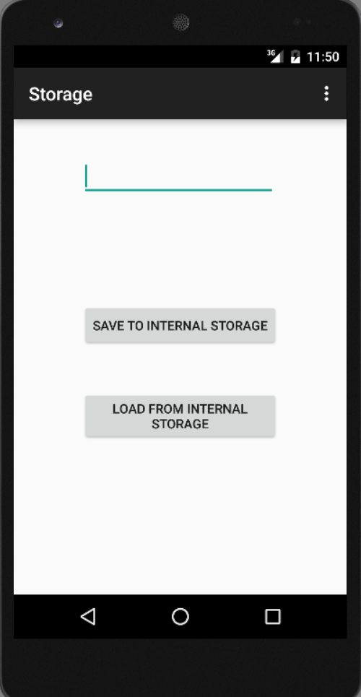
Demo: execute the application

Slide 24
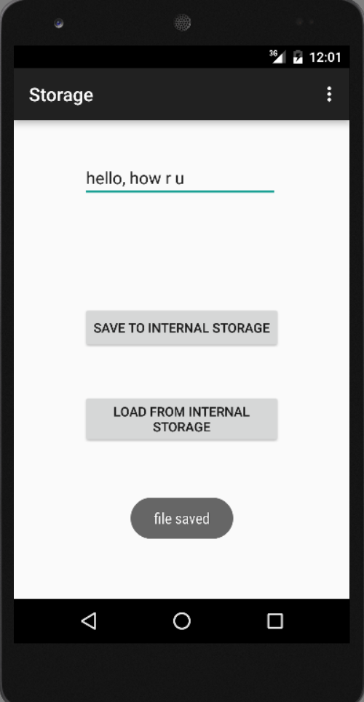
Demo: type in words and save

Slide 25
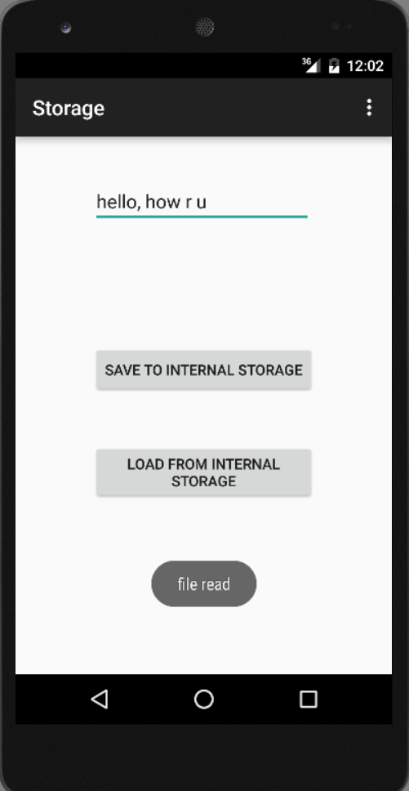
Demo: press load

Slide 26
Content outline
Options for data storage
Internal storage
Summary
Next lecture
Further readings

Slide 27
Summary
Options for data storage.
Internal storage:
Created EditText fields.
Use of openFileInput()/openFileOutput().
Use of FileInputStream().
Created EditText on the layout.

Slide 28
Content outline
Options for data storage
Internal storage
Summary
Next lecture
Further readings

Slide 29
next lecture
To introduce how to build SQLite database.

Slide 30
Content outline
Options for data storage
Internal storage
Summary
Next lecture
Further readings

Slide 31
Further readings
http://developer.android.com/training/index.html
Android Application Development for Dummies, Donn Felker, Wiley Publishing, Inc., NJ, 2011.

